Slide 1
New Employee Orientation
[Company Logo]
[Your Company Name]
[Year]

Slide 2
Emergency Preparedness
[Company Logo]
[Your Company Name]
[Year]

Slide 3
Emergency Preparedness
Emergencies in the workplace are brought about by both natural and man-made disasters.
Emergency preparedness is a well-known concept in protecting workers' safety and health.
Putting together a comprehensive emergency action plan involves conducting a hazard assessment to determine what, if any, physical or chemical hazards inside or from outside the workplaces could cause an emergency.

Slide 4
Standard Emergency Action Plan
Fire
Severe weather
Earthquake
Plumbing issue
Floods
Terrorism
Bioterrorism
Gunman/Active Shooter
Bomb Threat
Electrical outage
Medical emergency
Poisoning
Chemical spill

Slide 5
FIRE SAFETY
R - Rescue
A - Alarm
C – Contain
E – Extinguish/Evacuate

Slide 6
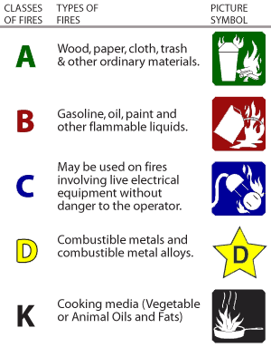
Fire Extinguisher Class Types

Slide 7
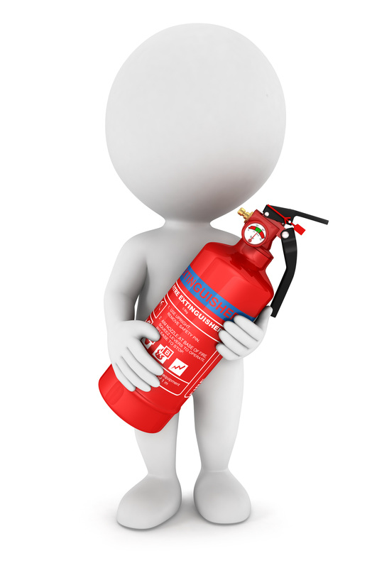
FIRE EXTINGUISHER USE
Regulation fire extinguisher for private office in Nevada is a Class 2A10BC serviced by a state licensed extinguisher company.
P- Pull
A- Aim
S- Squeeze
S- Sweep base

Slide 8
FIRE SAFETY
What to do:
Keep calm
Stay alert
Follow commands
Upon arrival of the fire department, all previous instructions are overridden by any command given by a firefighter.

Slide 9
Severe Weather
Main types of severe weather include:
Thunder storms
Blizzards
Hurricanes
Tornadoes
In the event of a severe weather storm your manager will inform you if the company is open for business.

Slide 10
Severe Weather Preparedness
In general, you should be sure you and your coworkers make the following precautions for any severe weather event:
Have plastic tarps, tape, and rope on hand to cover the equipment.
Cover windows.
Have an emergency medical kit
Have flashlights and batteries.
Have diesel for generators.
Secure all loose equipment and materials that are outside on site.
Back up all digital files.
Have walkie-talkies for emergency communication

Slide 11
Thunder and Lightening
If a thunder and lightening storm happens during work hours, you should take the following precautions.
Thunder and lightening storm
Avoid going outside where you may be struck by lightening
Should there be a power outage follow the recommendations for a power outage.

Slide 12
Blizzard
If a blizzard storm happens during work hours, you should take the following precautions.
Keep walkways clear during breaks in the storm
Use salt to reduce icing
Stay indoors whenever possible
If forced to go outside, wear adequate clothing
Tell someone when you are leaving and where you plan to go. Call them once you arrive to verify you arrived safely

Slide 13
Hurricane
If a hurricane storm happens during work hours, you should take the following precautions.
Secure doors and windows with tape and plywood boards
Stay in room without windows
Avoid contact with flood water, it could be electrified

Slide 14
Tornado
If a tornado storm happens during work hours, you should take the following precautions.
Move to a basement if available
Stay away from windows, doors, and outside walls.
If you are in a building with no basement, then get to a small interior room on the lowest level.

Slide 15
Earthquake
Duck, Cover and Hold in place until the shaking stops.
Stand in door ways and brace yourself or take cover under solid stable tables or desks
Face away from windows and stay clear of falling objects.
Stay Inside! Do not evacuate unless directed to do so.
Do not use the stairs until instructed that it is safe to do so.
Once the earthquake has stopped, survey your area. Report all injuries and damage to a manager
Be prepared for aftershocks.

Slide 16
After The Earthquake
After the earthquake
Use the phone only for an emergency
Check on patients and assist where possible
Do not use elevators
EXPECT AFTERSHOCKS

Slide 17
Plumbing Issues
The 10 Most Common Plumbing Issues
Dripping faucets.
Slow draining sink.
Clogged bath or shower drain.
Clogged toilet.
Running toilet.
Faulty water heater.
Low water pressure.
Jammed garbage disposal.
Leaky pipes.
Sewer system backup.

Slide 18
Plumbing Issues
If there is a small leak, contact the manager.
Place a pail or garbage can if leaking from ceiling.
For larger leaks that can lead to immediate flooding, turn of the water supply.
Your manager should inform you where the water turn of is in the event of an emergency plumbing flood.
Remove any moveable items from the flooding area
Turn off and unplug any electrical equipment. Remove from the area if possible.

Slide 19
FLOODS
If you are under a flood warning, find safe shelter right away
Do not walk, swim or drive through flood waters.
TURN AROUND, DON’T DROWN!
Just six inches of moving water can knock you down, and one foot of moving water can sweep your vehicle away.
Stay off of bridges over fast-moving water.
Depending on the type of flooding:
Evacuate if told to do so.
Move to higher ground or a higher floor.
Stay where you are.

Slide 20
TERRORISM
In the event of civil unrest or a terrorism incident, you will be notified by management on what to do, how to exit, and where to go.
Law enforcement, military, and/or government officials will advise you as to the nature of the situation, and what to do.

Slide 21
BIOTERRORISM
Bioterrorism Agent Categories
Bioterrorism agents can be separated into three categories, based on:
how easily they can be spread
the severity of illness or death they cause.

Slide 22
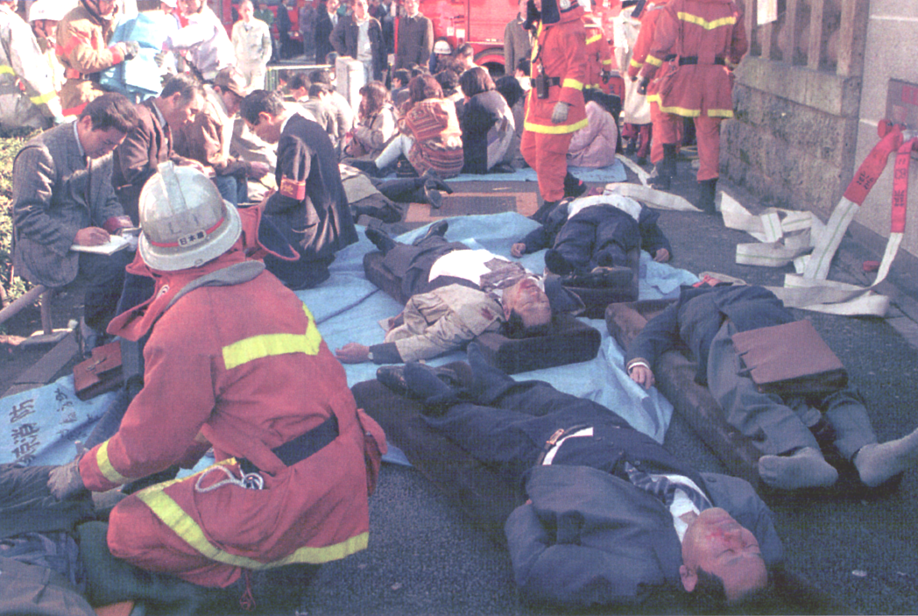
What Bioterrorism Does NOT Look Like

Slide 23
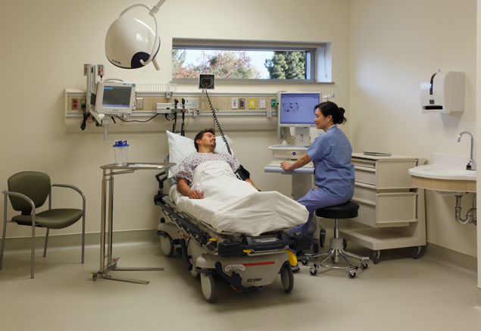
What Bioterrorism will likely look like:

Slide 24
Bioterrorism Preparedness
Stay Informed
Be aware of current threat
Know signs and symptoms
Know pathogenesis, incubation period
Know any possible treatments
Know local and CDC disease specific plans
Notify and coordinate with health officials
Monitor communications
Provide information

Slide 25
Gunman In The Workplace
SCENARIO 1
Run & Escape
Stay Calm and Think
React! Don’t freeze up.
If possible run away
Leave your stuff
Know escape routes
If within arms length, grab a weapon

Slide 26
Gunman In The Workplace
SCENARIO 2
Hiding and Barricading
If running is impossible, hide
Barricade yourself if possible
Lock and block the door
Call 911
Arm yourself
Turn off the lights
Find further cover under a table or desk
Turn off anything that makes noise
Stay calm
Play dead as a last resort

Slide 27
Gunman In The Workplace
SCENARIO 3
Engaging the Shooter
Exhaust all other options first
Do not try to reason with the gunman
Do not plead for your life
(these techniques have repeatedly been shown to be ineffective and often incite the gunman)
Work with others to create confusion
Attack the shooter with any object you can grab
Aim for the head – attempt to blind, knock unconscious
Be as aggressive as possible
Commit to the attack – do not hesitate or think too much
Throw objects, throw hard, and throw heavier things that can hurt

Slide 28
Preparation and Prevention
Be alert – recognize “out of the ordinary” behavior
Report suspicious activity
Be aware of exits and keep them clear
Know any organization’s “lockdown” procedure
Take a self defense class
If trained and licensed, carry a weapon

Slide 29
ARRIVAL OF POLICE
Do not run toward law enforcement
Do not try to “help” them
Keep your hands up and visible
Do not make any sudden movements
When asked, tell the police what you know
Move in the direction the police came in
Do not ask police questions
Obey police instructions immediately

Slide 30
BOMB THREAT
If a caller makes the threat, ask the following questions:
When will it explode?
Where/what type of device?
What does it look like?
What is your name?
Check caller ID for phone #.
Note caller’s voice/sounds.
Notify Security at 7-0020.
If there are any unusual items in your area, do NOT touch them.
Notify Security or management.

Slide 31
Electrical Outtage
A power outage is more than just having the lights go out. It can cause refrigerated inventory to spoil, disrupt communications, and prevent merchant sales.
In the event of a power outage:
Use flashlights
Have extra batteries available
Keep freezers and refrigerators closed.
Only use generators outdoors and away from windows.
Do not use a gas stove to heat your home.
Disconnect appliances and electronics to avoid damage from electrical surges.
Have alternate plans for refrigerated items
Have generator for pertinent specialty equipment

Slide 32
Medical Emergency
Call 911
Do not move the patient
If medical trained and certified, provide assistance

Slide 33
Poisoning
Call 911 for an ambulance, then call poison control
Call the Poison Control Center – 800-222-1222
Be able to provide the follow information:
Who was poisoned
How old is the person
What was the person exposed to
How much
When
If it was inhaled – get the person into fresh air
If person had poison touch clothing, remove clothing, unless it burned through clothing onto skin.
If on skin place in shower
If in eyes, rinse eyes with running water for 15 to 20 minutes.
If swallowed, do NOT try to vomit - it can make things worse. Wait for ambulance and follow directions of poison control.

Slide 34
CHEMICAL SPILL
Cordon off the area to make others aware to avoid that area.
For small spills of nontoxic chemicals that you know the hazards of and are comfortable cleaning up, you can clean up, but should inform the manager of the spill.
For larger spills, you should inform the manager and contact the workplace environmental services personnel.
For hazardous spills or very large spills (>4 liters) environmental services should be contacted to determine if outside assistance is required.

Slide 35
Emergency Action Plans
EAPs are provided to ensure your and everyone’s safety. Following the direction of your manager or emergency officials is critical to ensuring everyone’s safety.

Slide 36
Your Responsibilities
Know which workplace hazards can lead to an emergency
Know how to report emergencies
Know your role in an emergency
Know the responsibilities of your role
Know evacuation routes and procedures
Participate in emergency drills
Always keep emergency exits cleared
Respond emergencies when they arise

Slide 37
Emergency Responsibilities
Handle only tasks you’ve been assigned and trained for
Understand exactly what’s expected of you
Carry out responsibilities only if you can do so safely
Be able to locate assigned safe areas inside or outside the facility
Have at least two escape routes from your work area
Know where emergency exits are located in other parts of the facility
Know where to go for roll call once safely outside

Slide 38
During An Emergency
Recognize the evacuation signal and listen for instructions
Alert co-workers and customers
Shut down equipment
Move quickly but calmly
Follow directions from emergency response personnel
Proceed to the assembly area
Do not leave the area until instructed
Go directly to the nearest safe exit

Slide 39
Are Your Prepared?
How would you react to a fire alarm?
What would you do in a natural disaster such as a violent storm?
How do you clean up a chemical spill?
Do you know your role if there were a serious chemical or biohazard incident?
How would you respond to an act of violence?
What if an electrical cable is frayed and sparking?

Slide 40
OSHA Requirements
Evacuation and exit routes
Alarm systems
Protective measures
Training
Emergency action and fire prevention plans

Slide 41
EAP Kit
What to include in an EAP kit includes:
Type of workplace response – who does what and how
Location of emergency items:
Fire extinguishers
Flashlights
Buckets
Medical kit
AED
Safety apparel
Who is assigned to retrieve the needed emergency item
Communication protocols and hierarchy
Evacuation procedure
Meeting locations after evacuation
Securing assets – money, equipment, turning off power, etc
Emergency numbers

Slide 42
ALARMS
In the your workplace, knowing about the alarm system can make the difference of life and death during an emergency.
You are responsible for:
Knowing the location of alarms
Learning how to activate them
Knowing who to call after setting alarm
Knowing what to report to a supervisor

Slide 43
To Summarize
Identify workplace hazards that could cause an emergency
Report emergencies promptly
Carry out emergency responsibilities
Follow instructions
Evacuate quickly and safely
Respond to emergency situations effectively

