Slide 1
New Employee Orientation
[Company Logo]
[Your Company Name]
[Year]

Slide 2
OSHA
[Company Logo]
[Your Company Name]
[Year]

Slide 3
What Is OSHA?
Occupational Safety and Health Administration
Federal agency created as a result of the Occupational Safety and Health Act enacted in 1970
Assures a safe and healthful working environment for workers by setting and enforcing standards and by providing training, outreach, education and assistance.
The agency is also charged with enforcing a variety of whistleblower statutes and regulations
It is the duty of the employers to provide workplaces that are free of known dangers that could harm their employees
This law also gives workers important rights to participate in activities to ensure their protection from job hazards

Slide 4
Your Rights Under OSHA
You have the right to:
A safe and healthful workplace
Know about hazardous chemicals
Be free from retaliation for exercising safety and health rights
Report injury to employer
Complain or request hazard correction from employer
Training
Hazard exposure and personnel records
File a complaint with OSHA
Participate in an OSHA inspection

Slide 5
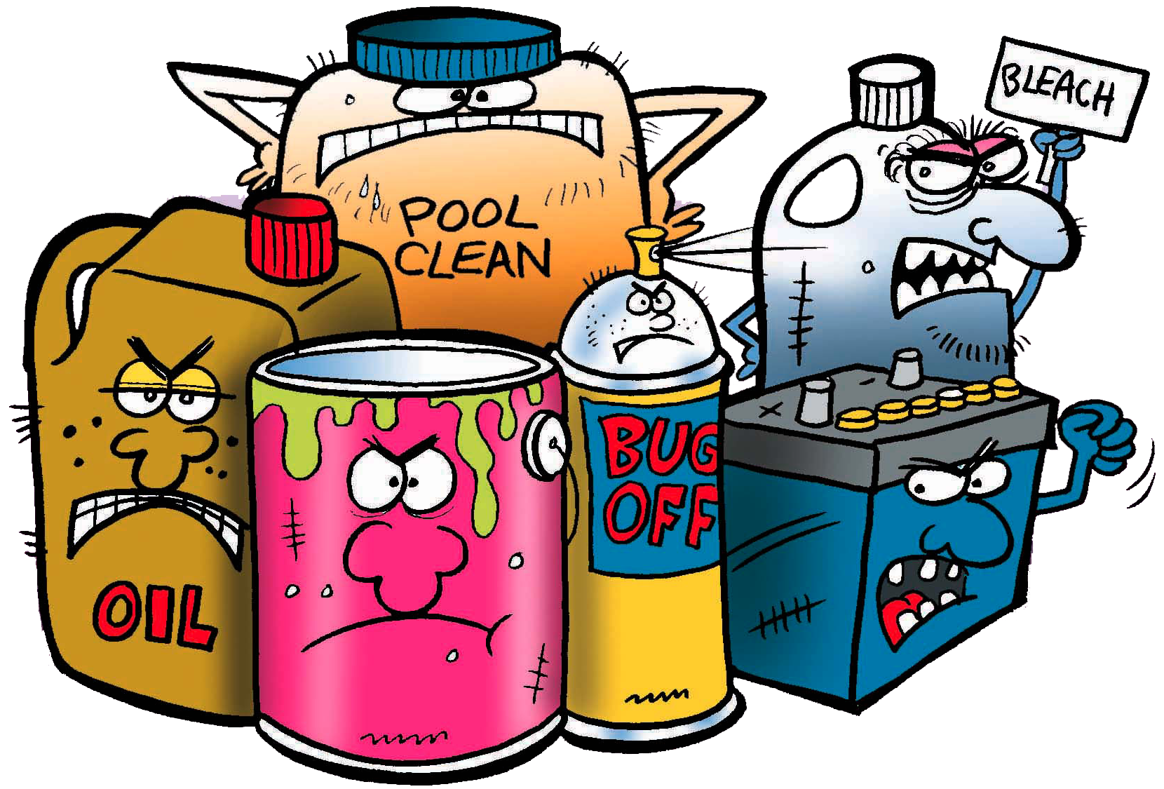
HAZARDOUS CHEMICALS
Employers must have a written, complete hazard communication program that includes information on:
Container labeling,
Safety Data Sheets (SDSs), and
Worker training.
The training must include the physical and health hazards of the chemicals and how workers can protect themselves

Slide 6
SAFETY DATA SHEETS
Provides workers and emergency personnel with procedures for handling or working with that substance in a safe manner, and includes information such as chemical properties, toxicity, health effects, first aid, reactivity, storage, disposal, protective equipment, and spill-handling procedures.
The Hazard Communication Standard (HCS) requires chemical manufacturers, distributors, or importers to provide Safety Data Sheets (SDSs) (formerly known as Material Safety Data Sheets or MSDSs) to communicate the hazards of hazardous chemical products. As of June 1, 2015, the HCS will require new SDSs to be in a uniform format.

Slide 7
REPORTING VIOLATIONS
Workers may bring up safety and health concerns in the workplace to their employers without fear of discharge or discrimination
OSHA rules protect workers who raise concerns to their employer or OSHA about unsafe or unhealthful conditions in the workplace (Whistleblower Protection)

Slide 8
OSHA
The Occupational Safety and Health Administration is an agency of the United States Department of Labor. Congress established the agency under the Occupational Safety and Health Act, which President Richard M. Nixon signed into law on December 29, 1970.

Slide 9
Why OSHA
Because until 1970, no uniform or comprehensive provisions existed to protect against workplace safety and health hazards.
On average, 15 workers die every day from work injuries. That’s approx., 5,600 workers annually.
Approximately 4 million non-fatal job injuries and illnesses reported.

Slide 10
OSHA’s Mission
OSHA’s mission
To save lives
To prevent injuries
To protect America’s workers
OSHA's mandate is to "Assure so far as possible every working man and woman in the Nation safe and healthful working conditions."

Slide 11
OSHA Methods
Provides for research
Establishes separate but dependent responsibilities and rights for employers/employees
Maintains reporting & recordkeeping system
Establishes safety training programs
Develops & enforces safety standards
Evaluates and approves state safety programs

Slide 12
OSHA Regulations
Establishes specific responsibilities to Employer
Establishes specific responsibilities to Employees
It does not cover self employed persons
Farms at which only immediate family members are employed
Workplaces already protected by other govt agencies under other federal laws
The OSH Act covers employers and employees either directly through federal OSHA or through an OSHA approved state program.
24 States, plus Puerto Rico and the Virgin Islands have approved programs.

Slide 13
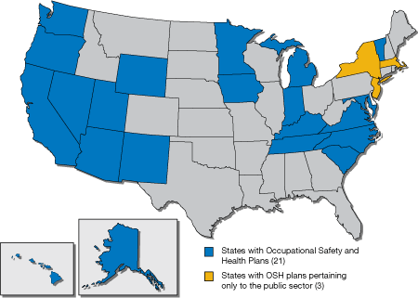

Slide 14
General Duty Clause
What is the General Duty Clause
How does OSHA use the General Duty Clause?
Steps company may take that go beyond compliance with OSHA standards

Slide 15
OSHA Strategies
To Help Reduce Injury and Death on the Job
Strong, fair, and effective enforcement.
Outreach, education, and compliance assistance.
Partnerships and other cooperative programs.

Slide 16
OSHA Inspections
OSHA has authority to certify
Normally notice is NOT given
Employee’s representative must be informed
OSHA generally conducts inspections without advance notice. In fact, anyone who alerts an employer in advance of an OSHA inspection can receive a criminal fine of up to $1,000, or a six-month jail term or both.
Under special circumstances, OSHA may give the employer advance notice of an inspection—but no more than 24 hours.
These special circumstances include:
Imminent danger situations, which require correction immediately.
Inspections that must take place after regular business hours, or require special preparation.
Cases where OSHA must provide advance notice to assure that the employer and employee representative or other personnel will be present.
Situations in which OSHA determines that advance notice would produce a more thorough or effective inspection.

Slide 17
Reasons for Inspections
Imminent Danger or any condition where there is reasonable certainty that a danger exists that can be expected to cause death or serious physical harm immediately.
Catastrophes and fatal accidents resulting in the death of any employee or the hospitalization of three or more employees.
Employee complaints involving imminent danger or an employer violation that threatens death or serious physical harm.
Referrals from other individuals, agencies, organizations, or the media.
Planned, or programmed, inspections in industries with a high number of hazards and associated injuries.
Follow-ups to previous inspections.

Slide 18
Stages of Inspection
Presentation of inspector credentials.
An opening conference.
An inspection walk-around.
A closing conference.

Slide 19
On Site Inspection
After the opening conference, the compliance officer and accompanying representatives proceed through the establishment, inspecting work areas for potentially hazardous working conditions.
The compliance officer will discuss possible corrective actions with the employer.
OSHA may consult, at times privately, with employees during the inspection walk-around.
An inspection walk-around may cover only part of an establishment – particularly if the inspection resulted from a specific complaint, fatality, or catastrophe, or, is part of a local or national emphasis program.
Other inspections may cover the entire facility, “wall to wall.”
Trade secrets observed by the compliance officers are kept confidential.
Federal employees who release confidential information without authorization are subject to a $1,000 fine, one year in jail, or both, and removal from office or employment.

Slide 20
Records Review
The compliance officer checks posting and recordkeeping practices, including whether the employer has:
Maintained records of deaths, injuries, and illnesses;
Posted OSHA’s Summary of Work-Related Injuries and Illnesses (OSHA 300A) from February 1 to April 30.
Prominently displayed the OSHA “It’s The Law” poster (OSHA 3165).
The compliance officer also examines records, where required, of employee exposure to toxic substances and harmful physical agents.

Slide 21
Citations
Regulations and standards the employer allegedly violated.
Any hazardous working conditions covered by the OSH Act’s general duty clause.
The proposed length of time set for abatement of hazards.
Any proposed penalties.

Slide 22
Penalties
Only the OSHA area director has the authority to tell the employer what penalties the agency will propose.
OSHA has up to six months following an inspection to issue a final report.
After reviewing the full inspection report, the OSHA area director will:
Issue citations without penalties.
Issue citations with proposed penalties.
Determine that neither are warranted.
A violation where there is substantial probability that death or serious physical harm could result and that the employer knew, or should have known, of the hazard.

Slide 23
Penalties
OSHA may propose a mandatory penalty of up to $7,000 for each serious violation.
A violation that has a direct relationship to job safety and health, but probably would not cause death or serious physical harm.
OSHA may propose a penalty of up to $7,000 for each other-than-serious violation.
A violation that the employer intentionally and knowingly commits or a violation that the employer commits with plain indifference to the law. The employer either knows that what he or she is doing constitutes a violation, or is aware that a hazardous condition existed and made no reasonable effort to eliminate it.
OSHA may propose penalties of up to $70,000 for each willful violation, with a minimum penalty of $5,000 for each willful violation
A violation of any standard, regulation, rule, or order where OSHA finds a substantially similar violation during a re-inspection.
OSHA may propose penalties of up to $70,000 for each repeated violation. To be the basis of a repeat citation, the original citation must be final.
OSHA may propose an additional penalty of up to $7,000 for each day an employer fails to correct a previously cited violation beyond the prescribed abatement date.

Slide 24
Penalties
Violating posting requirements can bring a civil penalty of up to $7,000. (OSHA does not fine for failing to post the “It’s The Law” poster (OSHA 3165).
Falsifying records, reports, or applications, upon conviction in a court, can bring a criminal fine of $10,000 or up to six months in jail, or both.
Assaulting a compliance officer or otherwise resisting, opposing, intimidating or interfering with a compliance officer in the performance of his or her duties is a criminal offense.
Anyone convicted of such an action is subject to a criminal fine of not more than $5,000 and imprisonment for not more than three years.
An employer who is convicted in a criminal proceeding of a willful violation of a standard that has resulted in the death of an employee may be fined up to $250,000 (or $500,000 if the employer is a corporation) or imprisoned up to six months, or both.
A second conviction doubles the possible term of imprisonment.

Slide 25
Recordkeeping
OSHA Recordkeeping Requirements 29 CFR 1904
OSHA’s reporting and recordkeeping regulations require employers to:
Maintain records in each establishment of occupational injuries and illnesses as they occur, and make those records accessible to employees.
Keep injury and illness records and post from February 1 through April 30 an annual summary of occupational injuries and illnesses for each establishment.
A company executive must certify the accuracy of the summary.

Slide 26
Employer Requirements
Record any fatality regardless of the length of time between the injury and the death.
Provide, upon request, pertinent injury and illness records for inspection and copying by any representative of the Secretaries of Labor or HHS, or the state during any investigation, research, or statistical compilation.
Comply with any additional recordkeeping and reporting requirements in specific OSHA standards.

Slide 27
Multiple Worksites
Employers must keep injury and illness records for each establishment.
OSHA defines an establishment as a “single physical location where business is conducted or where services are performed.”
An employer whose employees work in dispersed locations must keep records at the place where the employees report for work.
In some situations, employees do not report to work at the same place each day. In that case, records must be kept at the place from which they are paid or at the base from which they operate.
Each employer must complete the OSHA 301 form within seven calendar days from the time the employer learns of the work-related injury or illness.
This form includes more data about how the injury or illness occurred.
Employees and former employees are guaranteed access to their individual OSHA 301 forms. Employee representatives will be provided access to the “information about the case” section of the OSHA 301 form in establishments where they represent employees.

Slide 28
Form 300A
OSHA Form 300A Summary of Work-Related Injuries and Illnesses
This form was created to make it easier to post and calculate incident rates.
Employers must post copies of the previous year’s records no later than February 1 and keep them in place through April 30.

Slide 29
To Summarize
OSHA is in place to prevent workplace injury and death
It requires your employer to provide certain safety precautions and workplace provisions
The rules are there to keep you and your coworkers safe.

