Slide 1
New Employee Orientation
[Company Logo]
[Your Company Name]
[Year]

Slide 2
Ergonomics and Preventing Injuries
[Company Logo]
[Your Company Name]
[Year]

Slide 3
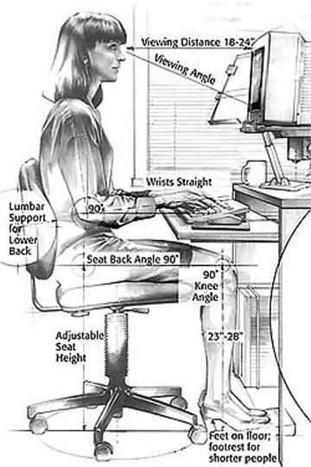
ERGONOMICS
The study of designing equipment and devices that fit the human body and its cognitive abilities to maximize workplace efficiency and productivity
The practice of designing products, systems, or processes to take proper account of the interaction between them and the people who use them.
Multiple areas of study contribute this field:
psychology
engineering
biomechanics
industrial design
physiology
anthropometry
(study of measurements of the human body)

Slide 4
ERGONOMICS
Risk Factors
Related Ailments
Working in awkward positions/poor alignment
Prolonged sitting and standing
Bending, reaching, stretching
Driving for extended periods of time
Repetitive actions
Heavy lifting
Awkward lifting/Lifting while twisting
Pushing, pulling, carrying
Accidents, slips, trips, falls
Vibration
Carpal tunnel syndrome
Low back pain
Sciatica
Neck pain
Muscle tension/cramps
Headaches
Poor sleep
Shoulder problems (rotator cuff)
Tennis Elbow
Fatigue
Numbness/Tingling
Decreased ROM
Loss of strength

Slide 5
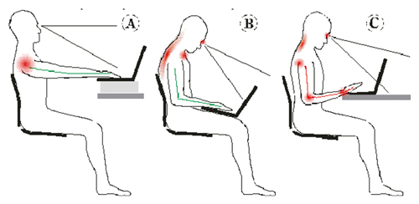
ERGONOMICS

Slide 6
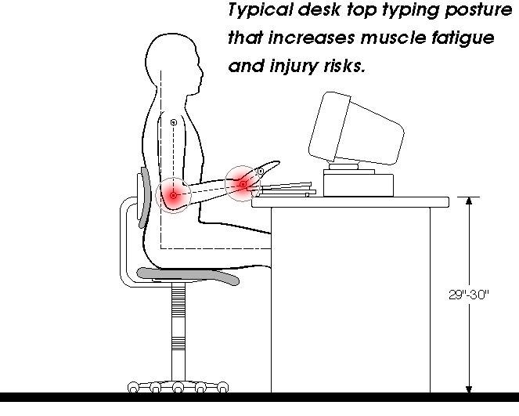
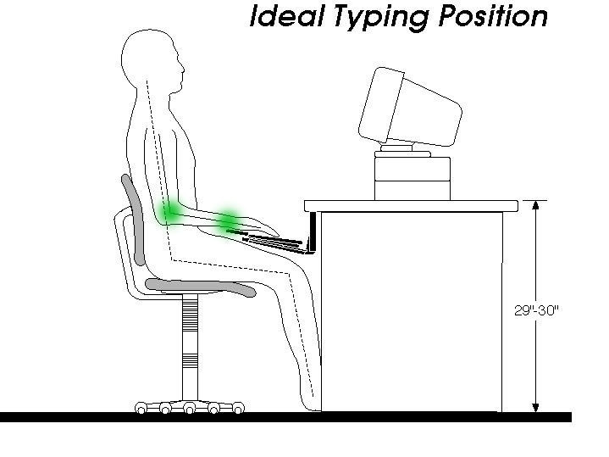
ERGONOMICS

Slide 7
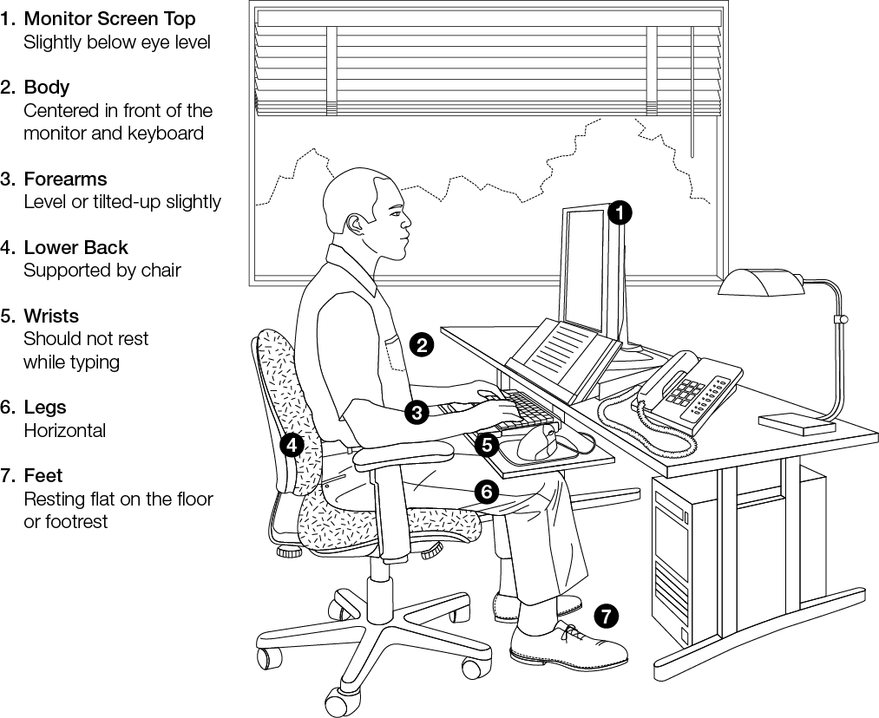

Slide 8
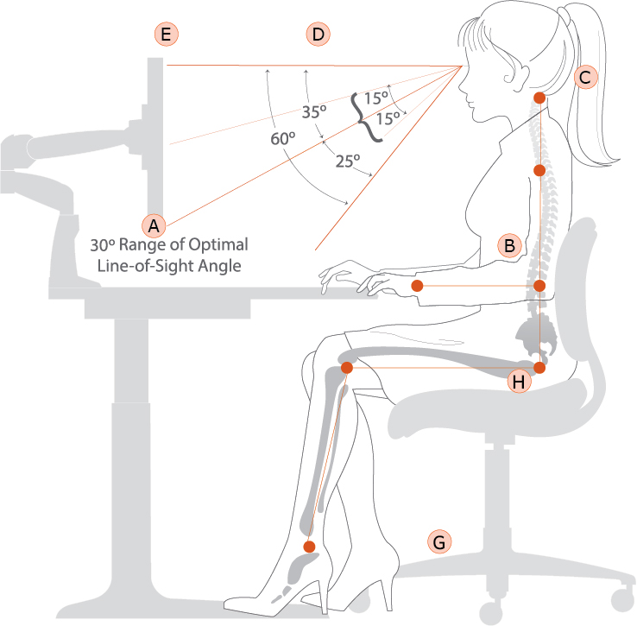
NEUTRAL POSITION
Neutral posture:
Back supported by the chair back
Ears, Shoulders, Elbows, Hips vertically aligned
Elbows, hips, knees bent at near-right angles (90º – 105º)
Feet flat on the floor or footrest
The basic neutral position most lab personnel should utilize a majority of the time they spend seated at the computer or other equipment.

Slide 9
BACK RELIEF
Forward tilt posture:
Raise the chair height a few inches and tilt the front downward slightly (8º - 10º)
Opens hip angle allowing legs to support some weight.
Not recommended if you have knee or foot problems.
May be used occasionally throughout the day by most people; but is not recommended for long periods at a time.

Slide 10
LOWER BODY RELIEF
Reclining posture:
Lean back 10º - 20º into the chair's backrest and put your feet out in front of you.
Opens hip and knee angles to help relax back muscles and promotes blood circulation. Leaning back too far can result in an awkward neck posture.
May be used occasionally throughout the day by most people; but not recommended for long periods at a time.

Slide 11
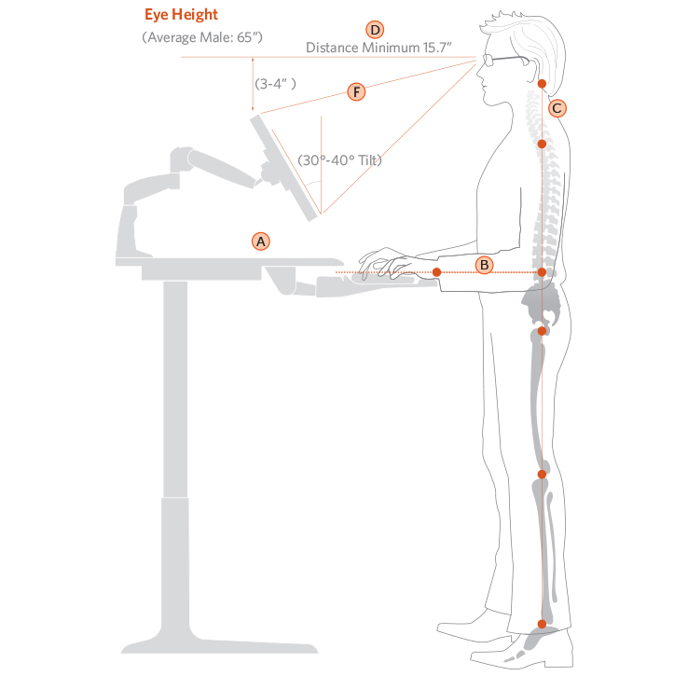
NEUTRAL STANDING
Standing posture:
Provides biggest change in posture
Good alternative to prolonged sitting
Can be fatiguing, have chair available
Prop one foot up on a low footrest to help occasionally shift your weight.
May be used occasionally throughout the day by most people; but not recommended for long periods at a time.

Slide 12
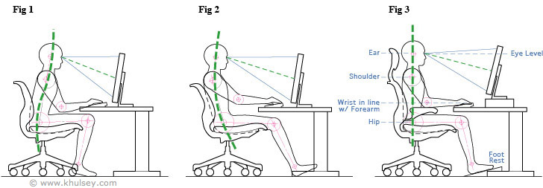
ERGONOMICS
POSTURE CHECK

Slide 13
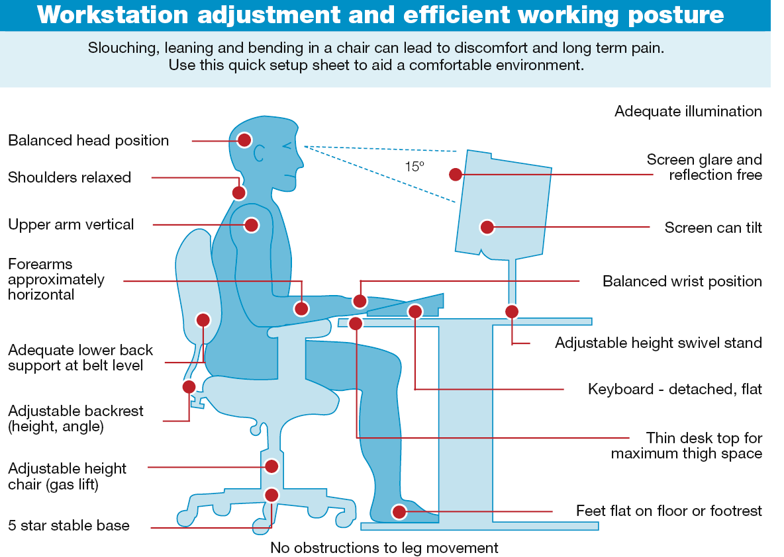

Slide 14
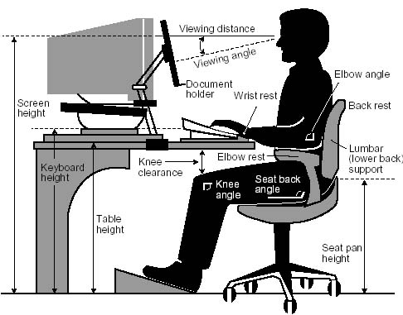
ERGONOMICS
Positioning:
Monitor directly in front of keyboard
18”-24” from eyes
Horizontal line of sight at 90° to monitor
Elbows at 90°
Keyboard angled to place wrists in alignment
Chair lumbar support at L4-L5
Knees slightly passed 90° with foot support

Slide 15
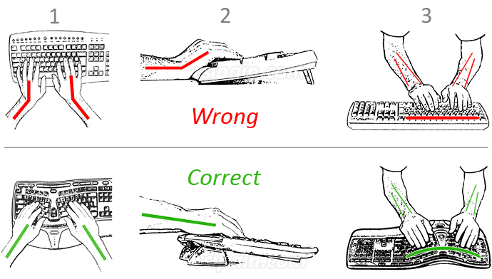

Slide 16
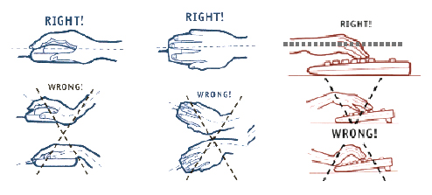

Slide 17
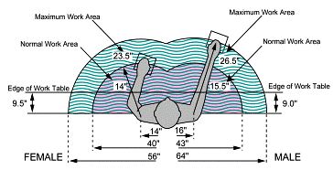
ERGONOMICS

Slide 18
Musculoskeletal Disorders
MSDs are injuries to the muscles, tendons, ligaments, and bones of the body.
They are most commonly caused by a repetitive use motion, vibration, or sudden stress such as lifting a heavy box.
Work-related MSDs are among the most frequently reported causes of lost or restricted work time.
According to the Bureau of Labor Statistics (BLS) in 2013, MSD cases accounted for 33% of all worker injury and illness cases.
Work-related MSDs can be prevented.

Slide 19
MSD Risk Factors
In the workplace, the number and severity of MSDs resulting from physical overexertion, and their associated costs, can be substantially reduced by applying ergonomic principles.
Injury Factors
Duration
Frequency
Intensity
Combination
Duration – You usually need hours of exposure before risk factors become a concern
Exposure can be all at one time or cumulative over the day

Slide 20
MSD Risk Factors
Frequency is often a concern in:
assembly tasks
sorting tasks
loading or off-loading materials
inventorying products
product stocking
software programming
telemarketing
customer service
Intensity refers to:
weight in pounds of items lifted or carried
grip or pinch force of lifted or manipulated items
vibration level (meters/second²)
force on keys when typing

Slide 21
MSD Risk Factors
Combination of risk factors:
Exposure to more than one risk factor at a time greatly increases the risk of injury.
For example:
Bending and twisting while lifting
Repetitive, forceful use of the hands with the wrists bent

Slide 22
MSD Symptoms
Discomfort
Pain
Numbness
Tingling
Burning sensation
Swelling
Change in color, bruising, redness
Tightness, loss of flexibility

Slide 23
Reporting Symptoms
Report symptoms if:
Pain is persistent, severe or worsening
Pain radiates
Symptoms include numbness or tingling
Symptoms keep you from sleeping at night
Onset of pain is sudden and severe after performing a task
You feel pain after feeling or hearing a “pop”

Slide 24
Be Warned
Minor injuries can easily become chronic injuries and can sometimes lead to disability, even surgery
Early treatment is always more successful

Slide 25
Reduce Risk
Take standard breaks
Scheduled vs. Spontaneous Work-Breaks
Micro breaks every 5 – 10 min
Standing
Taking short walks
Using keyboard options over mouse

Slide 26
Reduce Risk
Center of Gravity - Injury is caused when lifting or carrying is done outside the body’s center of gravity.
Lifting, carrying, and twisting in a reaching position is almost always going to lead to accidents and injuries.
Reduce Reaching
Keep items within close reach (design reach distance for the shortest worker)
Remove obstacles
Use gravity feed racks

Slide 27
ERGONOMICS
PROPER LIFTING
PREVENTING BACK INJURIES
80% of Americans will have a back injury that requires medical attention
Back injuries are the second most common cause of days away from work, next to the common cold
Injured backs are often subject to reinjury
In addition to missed work, there may be a lifetime of pain

Slide 28
Correct Posture
We’ve all been taught chin up, chest out, shoulders back. But that does not provide for a relaxed form in correct body alignment.
Correct posture is achieved by standing or sitting upright and pushing your shoulders downward. This opens the neck and upper spine to allow the lower spine to absorb the weight of the torso allowing the entire spine to bear the workload of the body’s weight.

Slide 29
Proper Body Mechanics
Stand with your feet apart to create a sturdy foundation.
Create a small hallow in your lower back by tucking the tailbone in and tilting your pelvic bone slightly forward. This is done by tightening the muscles of the buttocks and thus, rotating the pelvis into the neutral position. Be careful not to arch too much.
Bend at your knees instead of your waist.
Keep your neck, back, hips, and feet aligned when you move; avoid twisting and bending at the waist.

Slide 30
Proper Lifting
The process of lifting arguably places the greatest loads on the low back and therefore, has the highest risk of injury.
Use of proper lifting mechanics and posture is critical to prevent injury.
It is more important how you lift than how heavy a weight you lift. Here are a few tips on how to lift safely:
Place the load immediately in front of you.
Bend the knees to a full squat or lunge position.
Bring the load towards your chest.
Assume a neutral position with your back.
Tighten the lumbar and buttocks muscles to "lock" the back.
Lift now from the legs to the standing position.
DO NOT:
Lift from a twisted / sideways position.
Lift from a forward stooped / imbalanced position.

Slide 31
Protecting Yourself
Protect Yourself and Your Coworkers
Recognize and report symptoms
Get involved in ergonomics
Look at jobs
Come up with solutions
Work with solutions
Take part in training
Take responsibility for changing the way you do your job
Help to make sure efforts are successful

Slide 32
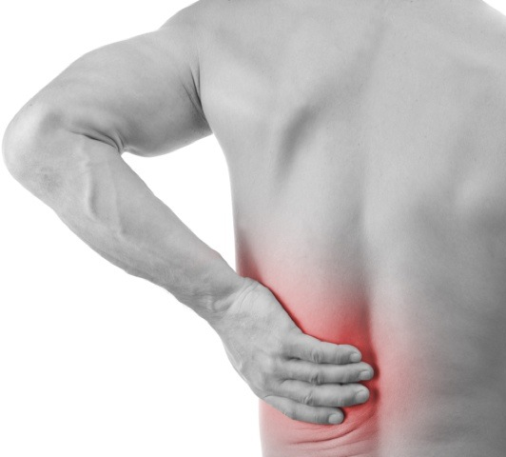
COMMON CAUSES OF BACK INJURIES
Lifting with back, not legs
Over Reaching
Poor standing/walking posture
Twisting while lifting
Poor sitting posture
Obesity
Falls
Lack of strength
Being “out of shape”
Underlying medical condition

Slide 33
Types of Back Injuries
Strain
Injury due to overusing or overstretching your back
Strain
Injury due to overusing or overstretching your back
Sprain
Sprain
Ligament in the back is torn or excessively stretched
Ligament in the back is torn or excessively stretched
Bulging disk
Bulging disk
Disk begins to come out from between two vertebrae
Disk begins to come out from between two vertebrae
Disk begins to leak its cushioning fluid
Herniated disk
Disk begins to leak its cushioning fluid
Herniated disk
Notes:
Slide Show Notes
Now we’ll cover the various types of back injuries and how they might occur.
A strain happens when you overuse or overstretch your back muscles. This often happens to people who try to do too much when their backs are not properly conditioned.
A sprain happens when a ligament in the back is torn or excessively stretched. This could be the result of a sudden forceful movement, or from a small movement that injures an already weak ligament.
A bulging disk occurs when a disk begins to come out from between two vertebrae. This can cause painful pressure on the spinal cord or other nearby organs. Often, the back muscles try to compensate for this injury, until the muscles themselves become strained.
Finally, a herniated disk occurs when the disk begins to leak its cushioning fluid. The disk loses its ability to cushion the vertebrae, resulting in pressure on vertebrae, the spinal cord, and possibly, other organs.
Ask trainees to describe other types of back injuries they have sustained on the job. Describe the types of back injuries that have occurred at the workplace (consult historic injury and illness logs) or within your industry.

Slide 34
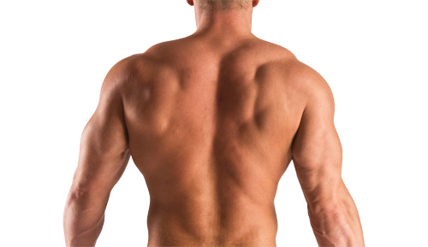
WAYS TO STRENGTHEN YOUR BACK
General physical conditioning (walking, jogging)
Back strengthening exercises
Abdominal muscle strengthening exercises
Proper lifting/moving techniques
Stretching
Weight Loss
Good Posture

Slide 35
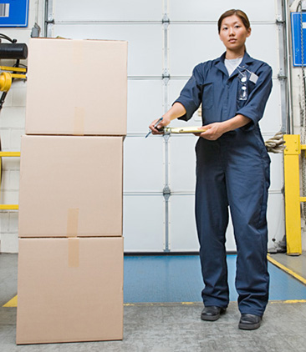
PREVENT INJURY
Safety First
Assess the situation
Do I need help?
Do I need any lifting equipment?
Is the path of movement clear ?

Slide 36
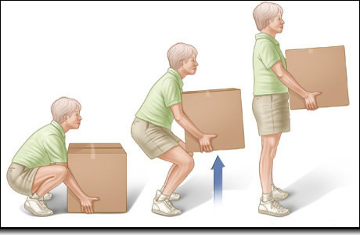
PROPER LIFTING
Stand close with a wide stance
Bend at the knees
Pull the load close and grip it
Tighten stomach, lift your head
Rise using your legs

Slide 37
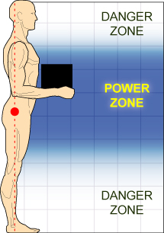
SAFE CARRYING
Always hold object close to your body with arms at 90°
Make sure you can see
Take small, stable steps
Do not twist your back

Slide 38
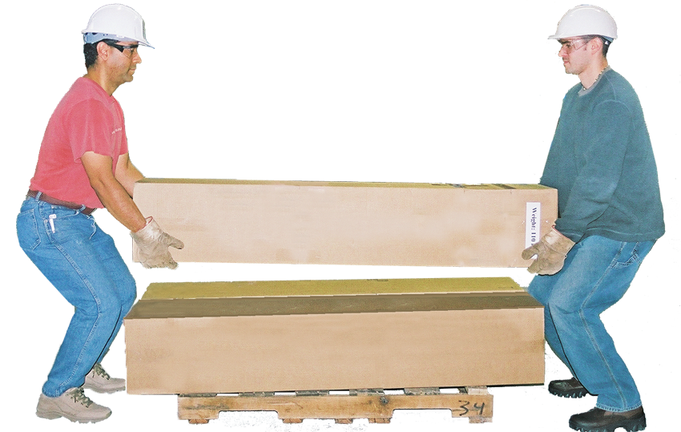
TEAM LIFTING
When more than one person is required to lift an object:
Designate a person to lead the lift
Lift at the same time
Keep the load level
Slowly unload together

Slide 39
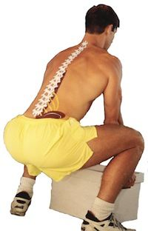
UNLOADING OBJECT
Proper unloading ergonomics are just as important as the lifting techniques.
Squat with the load
Do not bend your back over the load
Be careful of fingers
If more than one person, let others know when you have made contact with the ground or surface

Slide 40
To Summarize
Ergonomics is there to protect you and your coworkers from injury
Follow the rules
Use proper posture and body mechanics
Ask for help
Report risks and hazards
Report symptoms early
Help the company recognize the need for ergonomic changes that can help protect you and your coworkers

Slide 41
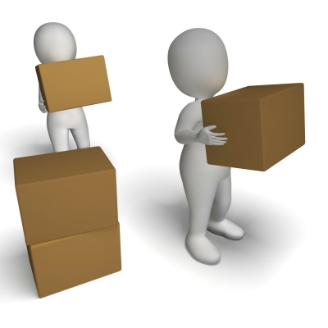
THINK LONG TERM
Be vigilant – always use proper lifting ergonomics
Think long term – how will this affect me 20 years from now?
Ask for help
Make multiple trips
Consider your back in all things you do

Slide 42
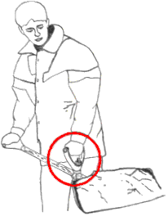
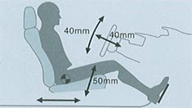
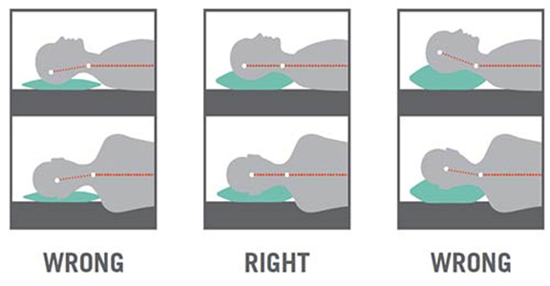
ERONOMICS IS EVERYWHERE
It’s not just for work
Car
Sleep
Household activities (ie: washing dishes, vacuuming)
Yard work
Snow shoveling

